Slide 1
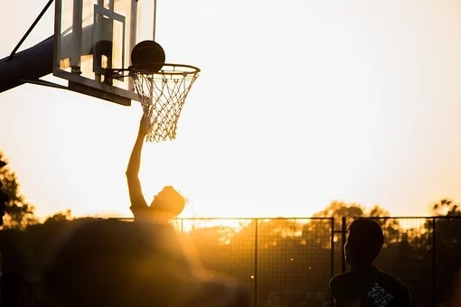
Unit 3 On the move
Understanding ideas

Slide 2
目录
I
Pre-reading
IV
Post-reading
II
Fast-reading
V
contents
Language points
III
Careful-reading
VI
Homework

Slide 3
I
Pre-reading

Slide 4
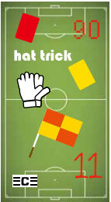
Pre-reading: Talk about what you think these things represent in a football game.
A football match consists of two 45-minute halves with a 15-minute rest period in between. Each game must include one referee and two assistant referees (linesmen). It’s the job of the referee to act as timekeeper and make any decisions such as fouls, free kicks, throw-ins and penalties.
referee 裁判员 foul 犯规 free kicks 任意球 throw-ins 界外球 penalty点球

Slide 5
Pre-reading: Talk about what you think these things represent in a football game.
The sport is played by two teams of 11 players (including one goalkeeper wearing gloves). The team captain is usually identified by the wearing of an armband with the letter “C” on it or other personalised patterns.
goalkeeper 守门员 armband 臂章；袖标
personalised 个性化的；个人化的

Slide 6
Pre-reading: Talk about what you think these things represent in a football game.
A player could receive either a yellow or red card if they commit a foul. The yellow card is a warning, while the red card results in the dismissal of that player. Two yellow cards will equal one red card. Once a player is sent off, they cannot be replaced.
commit a foul 犯规 dismissal 出局；开除

Slide 7
Pre-reading: Talk about what you think these things represent in a football game.
Corner flags are used to make it easy for
referees to tell if the ball crosses the touchline (which results in a throw-in) or the end line (which results in a goal kick or corner kick). If the ball hits a corner flag and bounces back onto the field, it is still in play!
touchline 边线 a goal kick 球门球
a corner kick 角球

Slide 8
Pre-reading: Talk about what you think these things represent in a football game.
A “hat trick” occurs in football when a player scores three goals in a single game.
hat trick 帽子戏法

Slide 9
II
Fast-reading

Slide 10
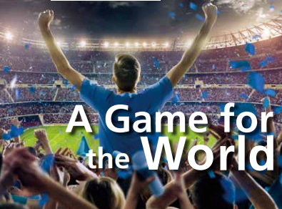
Fast-reading: Read & Answer
Read the passage and find out where modern football started.
Modern football started in Great Britain.

Slide 11
Fast-reading: Read & Choose
Choose the author’s purpose in writing the passage.
1. To talk about the history of football.
2. To express his / her love of football.
3. To explain why football is such a popular game.
4. To prove that he / she is a professional football fan.

Slide 12
III
Careful-reading

Slide 13
Careful-reading: Read & Understand
Complete the chart with expressions from the passage.

Slide 14

Opening
Football enjoys popularity all over the world and it has a
history that goes back to 1 ___________________.
Reason 1
It is 2____________.
Example
The young Pelé played football to his heart’s content with
3__________________
Reason 2
It is a game with
4 ____________.
Example
It is amazing to see how professional players use their bodies to 5 ______.
Reason 3
It breaks down walls and
6___________.
Example
British and German soldiers
put down their guns and
7______ on Christmas Day 1914.
Conclusion
Football is much more than just a sport.

Slide 15
Reason 1
It is 2____________
_________________.
Example
The young Pelé played football to his heart’s content with 3_______
___________________.
Football enjoys popularity all over the world and it has a
history that goes back to 1 _______________.
a simple and
cheap game to play
Opening
Ancient China
a ball
made of plastic bags

Slide 16
Reason 2
It is a game with
4 _______________
_________________.
Example
It is amazing to see how professional players use their bodies to 5 ____________________.
Football enjoys popularity all over the world and it has a
history that goes back to 1 _______________.
creativity and
Opening
excitement
Ancient China
pass, score and defend

Slide 17
Reason 3
It breaks down walls and 6_____________
__________________.
Example
British and German soldiers put down their guns and 7___________
_________________ on Christmas Day 1914.
Football enjoys popularity all over the world and it has a
history that goes back to 1 _______________.
brings people
together
Opening
played
Ancient China
football together

Slide 18
IV
Post-reading

Slide 19
Post-reading: Group Work
Think & Share
Discuss the following questions with your group members and share your ideas with the class.
1. What is your understanding of the last sentence of the passage?
2. What other sports are as popular as football in China? What makes them so popular?

Slide 20
Post-reading: Group Work
Think & Share
1. What is your understanding of the last sentence of the passage?
That football is much, much more important than life and death might sound funny. But when thinking about the Earth, which is shaped like a football, you can understand the importance of football in people’s minds.

Slide 21
Post-reading: Group Work
Think & Share
2. What other sports are as popular as football in China? What makes them so popular?
Table tennis is very popular in China for the following reasons.

Slide 22
Post-reading: Group Work
Think & Share
Firstly, table tennis only needs a big table. Compared to basketball, baseball and football, it takes up a much smaller space. Secondly, it is a safer sport compared to others which may involve physical contact between players. It’s convenient for schools to organise such exercise for PE classes. Thirdly, it’s a very simple game to play and both boys and girls can handle it quite well.

Slide 23
VI
Homework

Slide 24

Homework
1. Search the Internet to know
more about the history and
development of football.
2. Try to inquire more
information about your
favorite sport.

